Slide 1
Algorithms
Lecture #06
Dr.Sohail Aslam

Slide 2
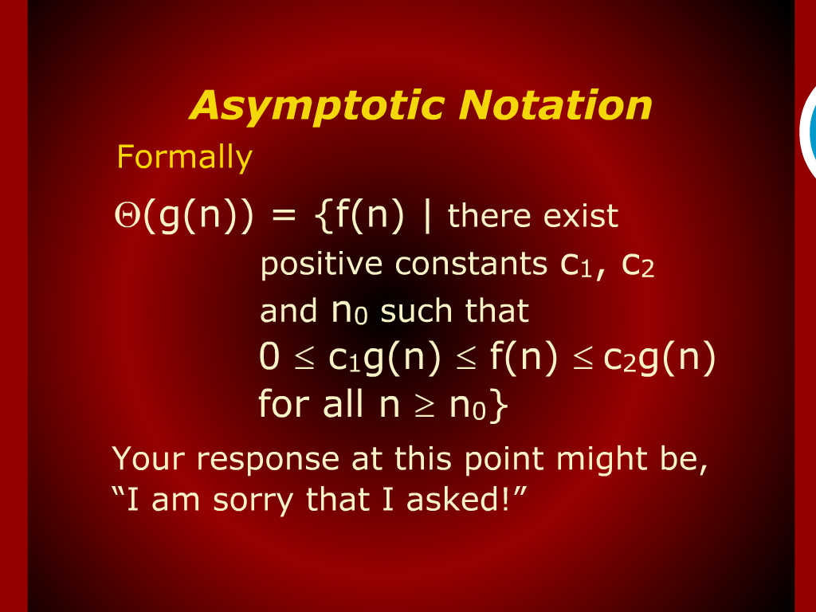
Asymptotic Notation

Slide 3
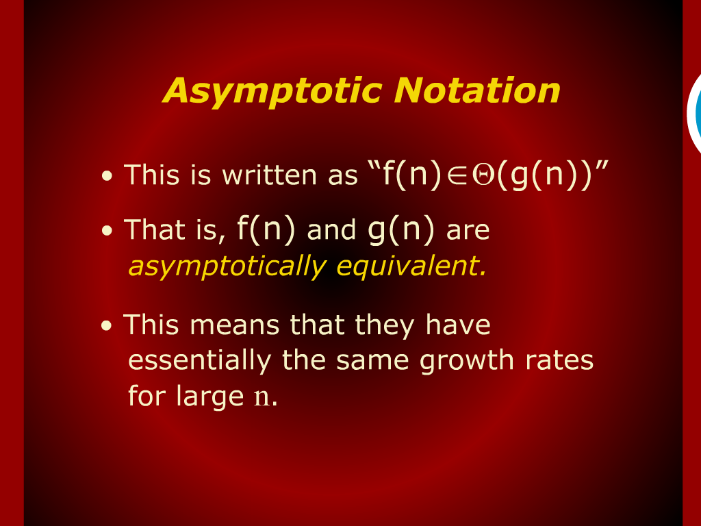
Asymptotic Notation

Slide 4
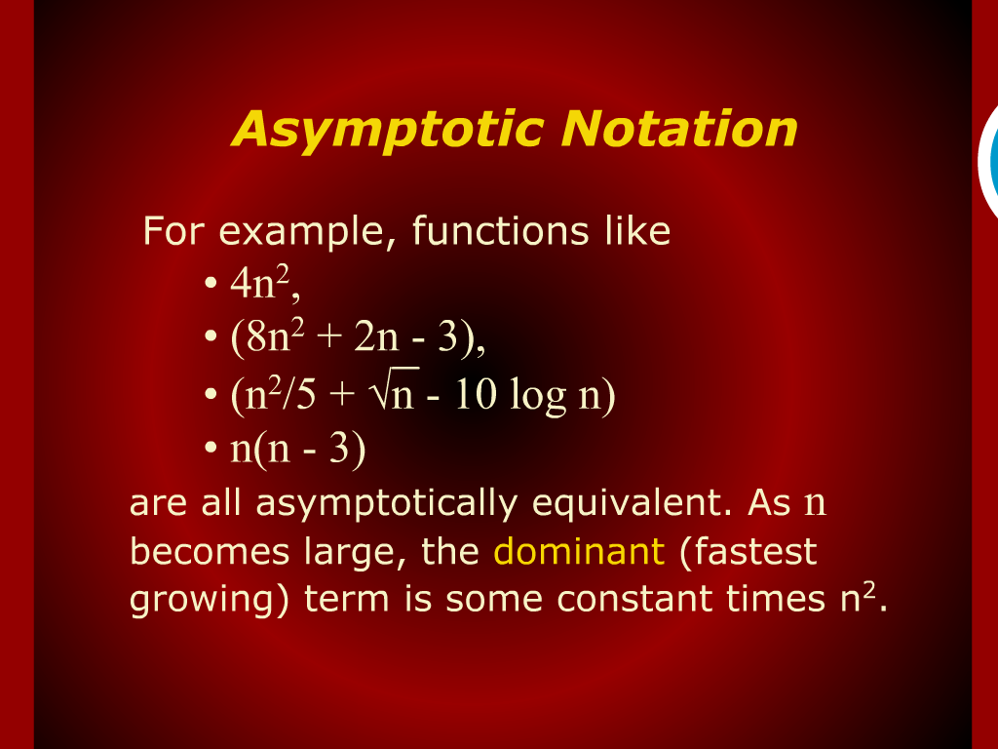
Asymptotic Notation - Example

Slide 5
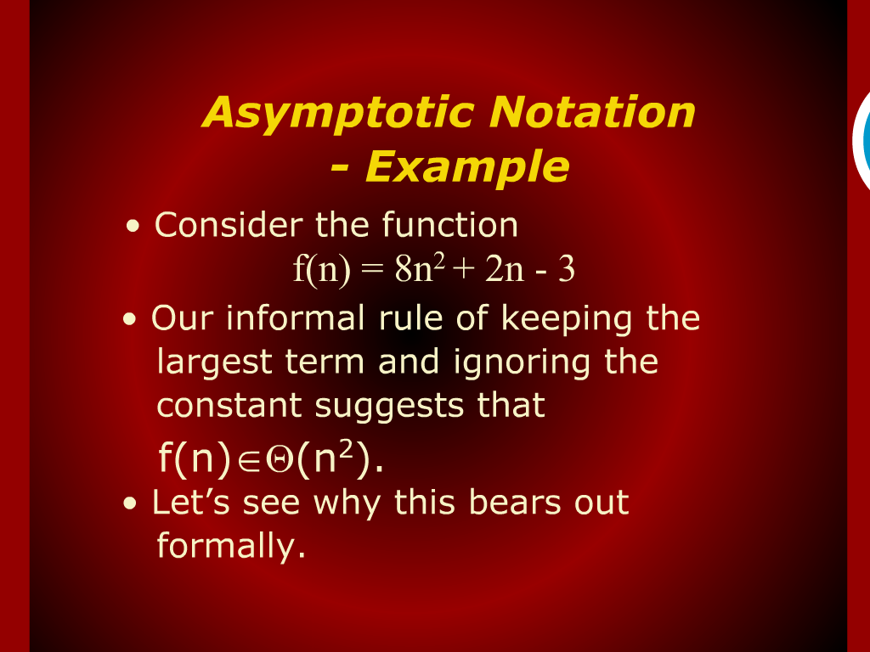
Asymptotic Notation - Example

Slide 6
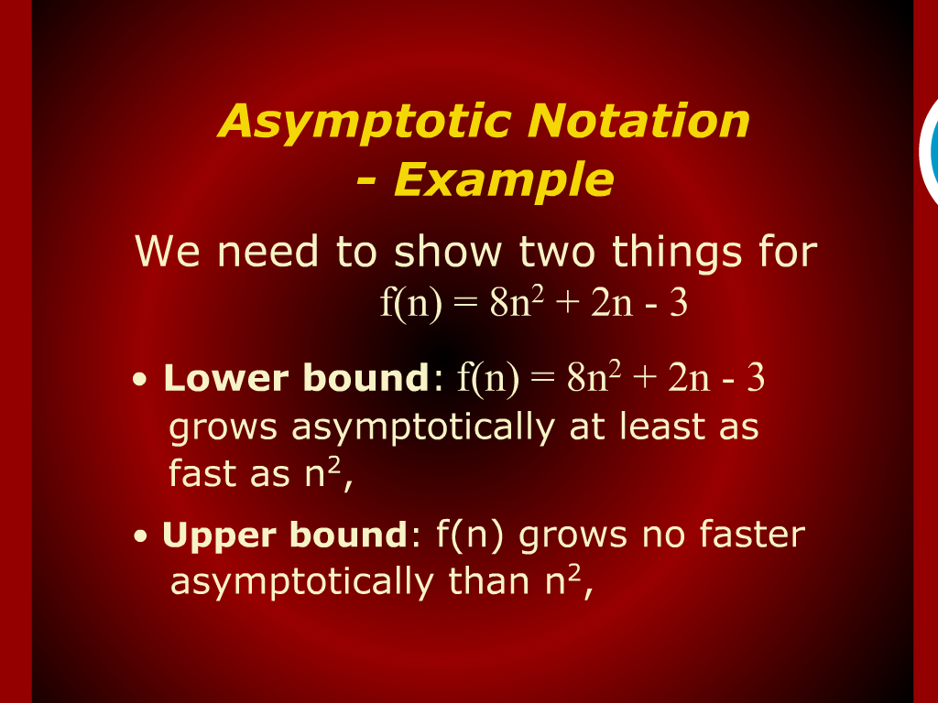
Asymptotic Notation - Example

Slide 7
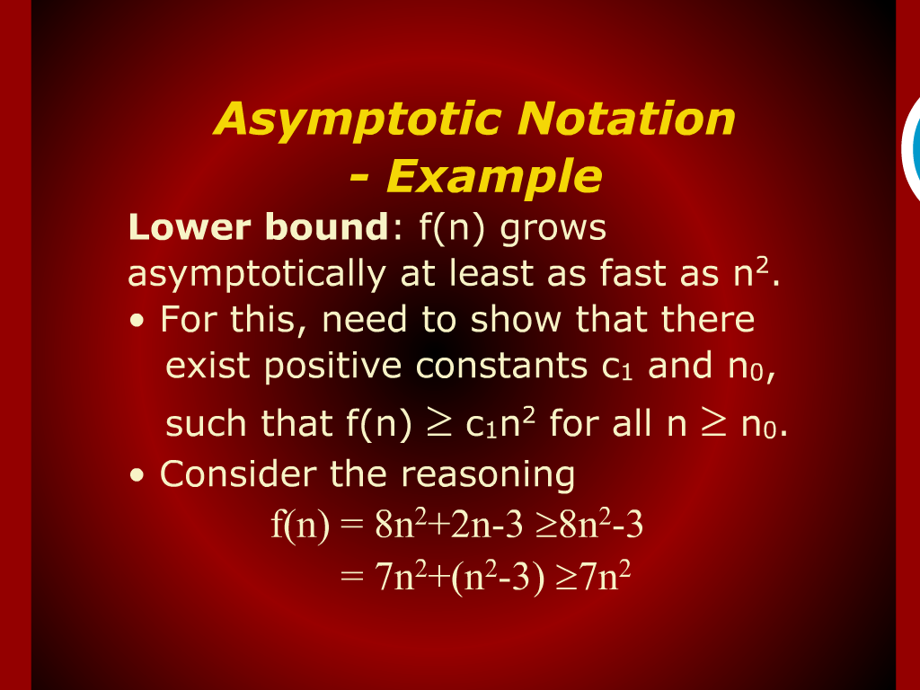
Asymptotic Notation - Example

Slide 8
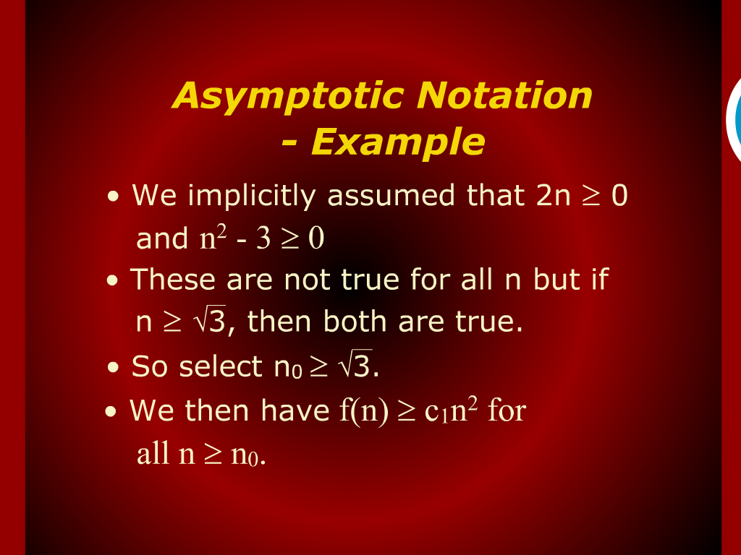
Asymptotic Notation - Example

Slide 9
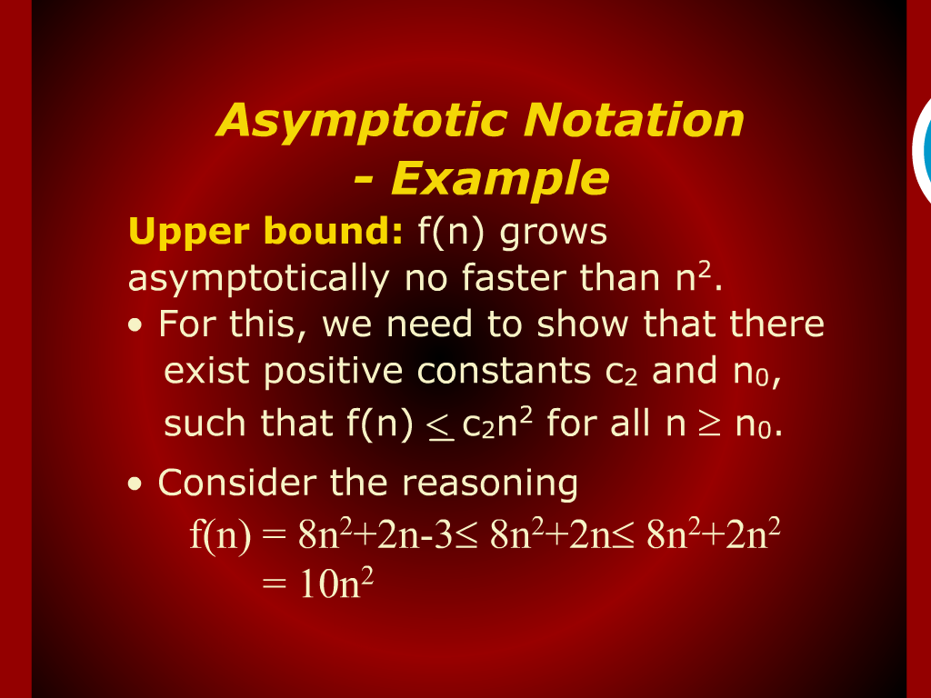
Asymptotic Notation - Example

Slide 10
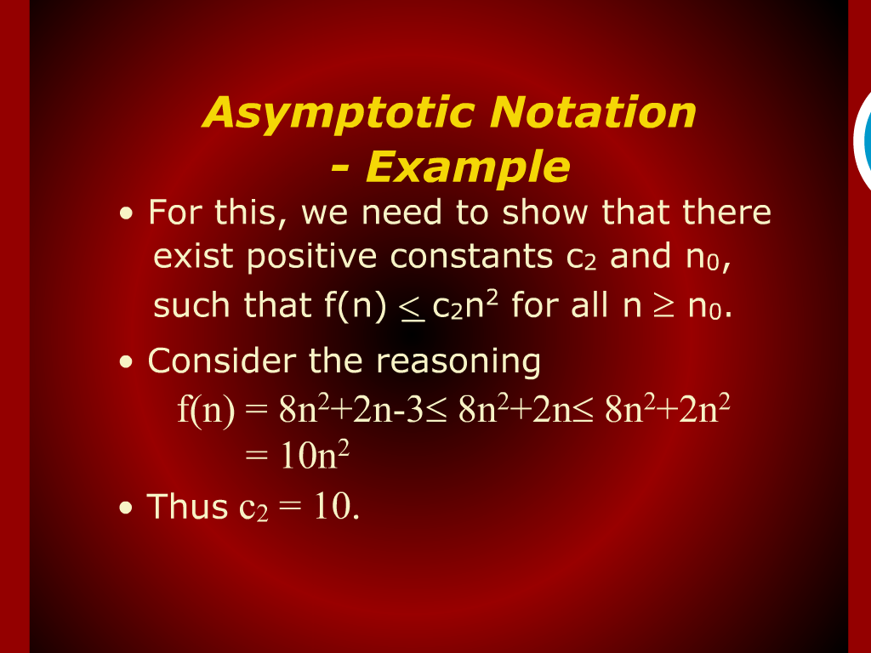
Asymptotic Notation - Example

Slide 11
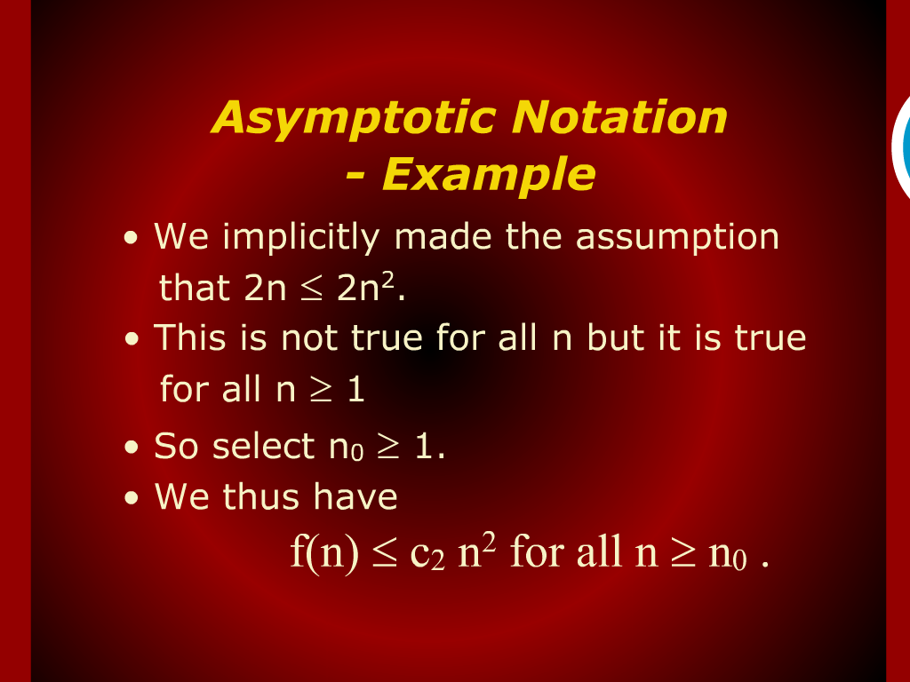
Asymptotic Notation - Example

Slide 12
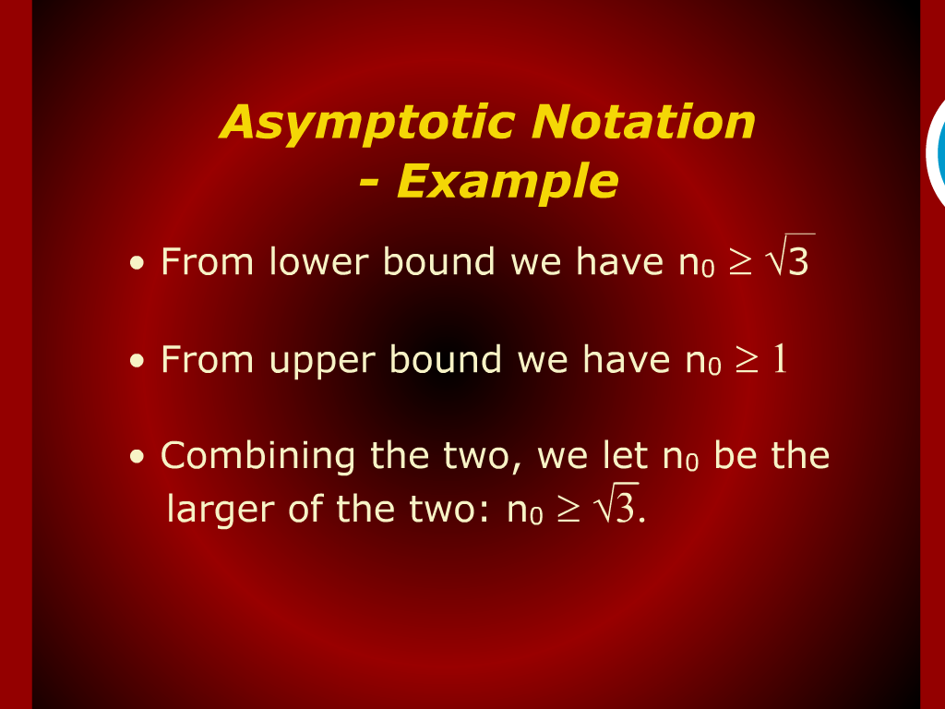
Asymptotic Notation - Example

Slide 13
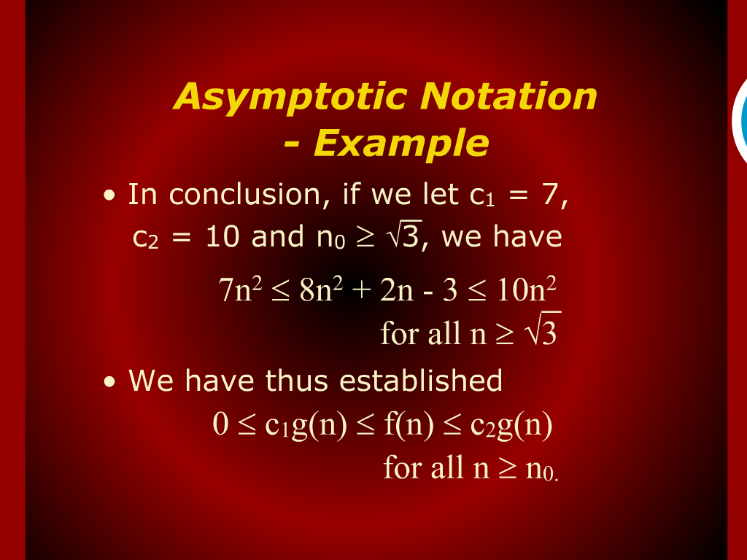
Asymptotic Notation - Example

Slide 14
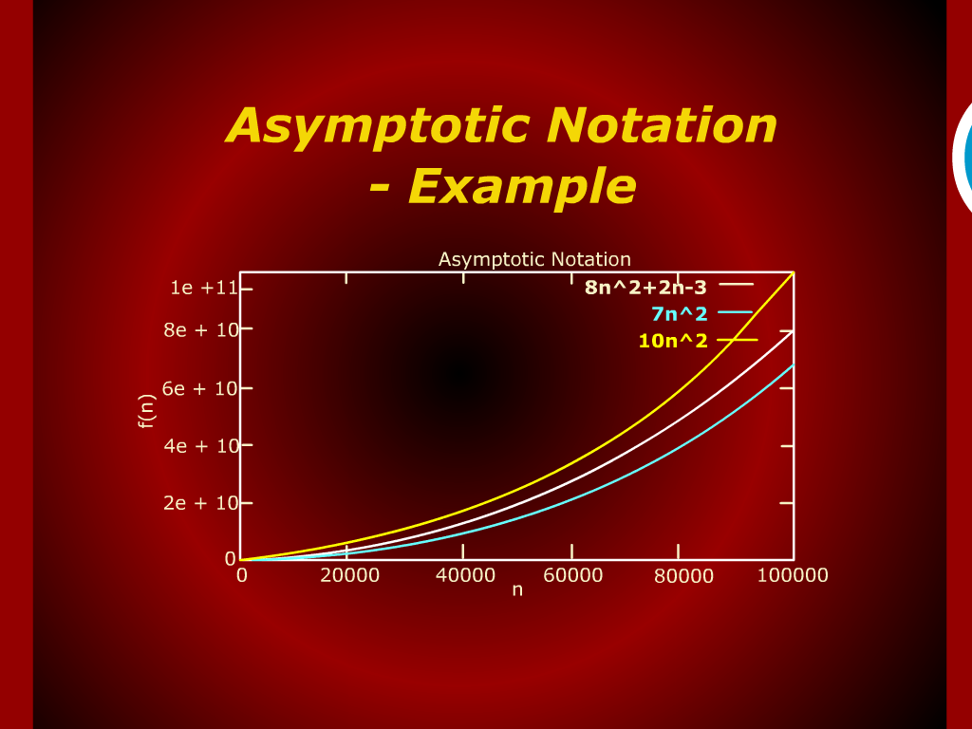
Asymptotic Notation - Example

Slide 15
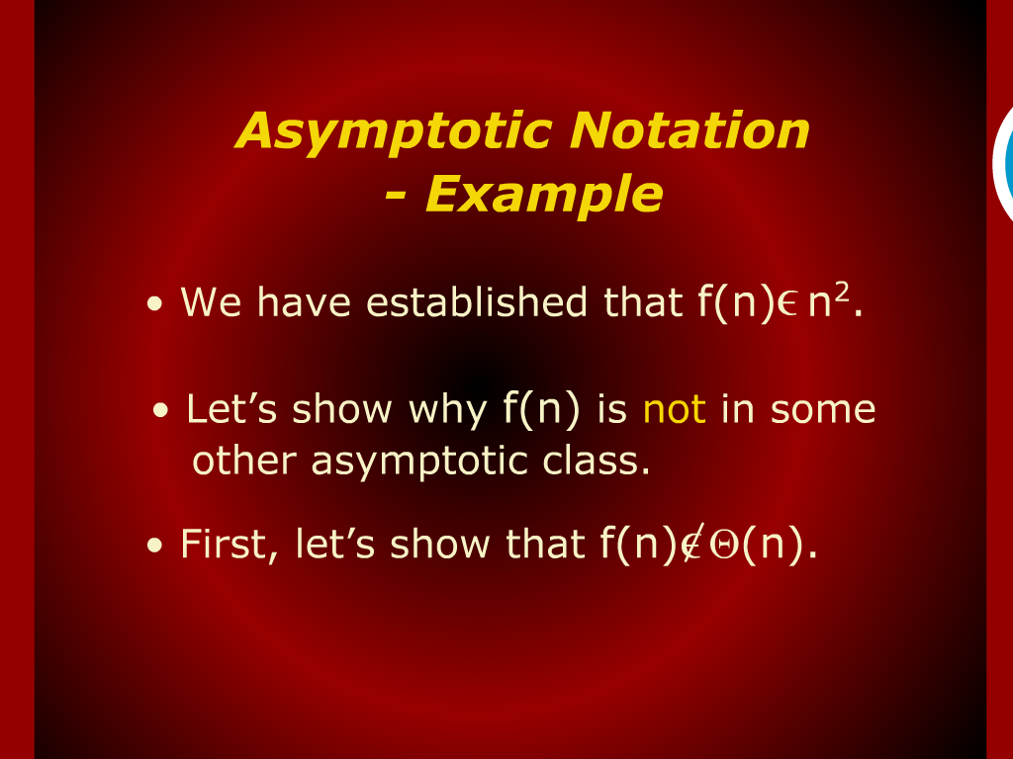
Asymptotic Notation - Example

Slide 16
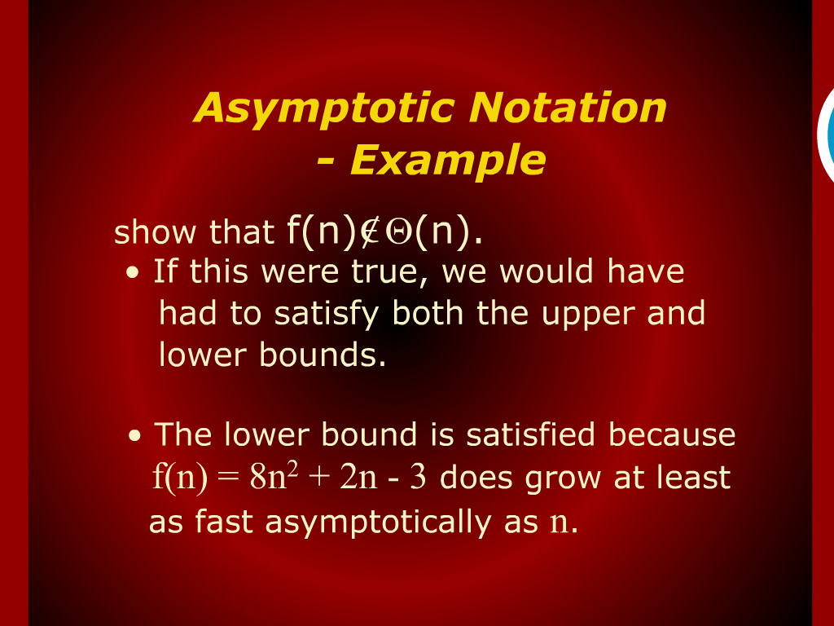
Asymptotic Notation - Example

Slide 17
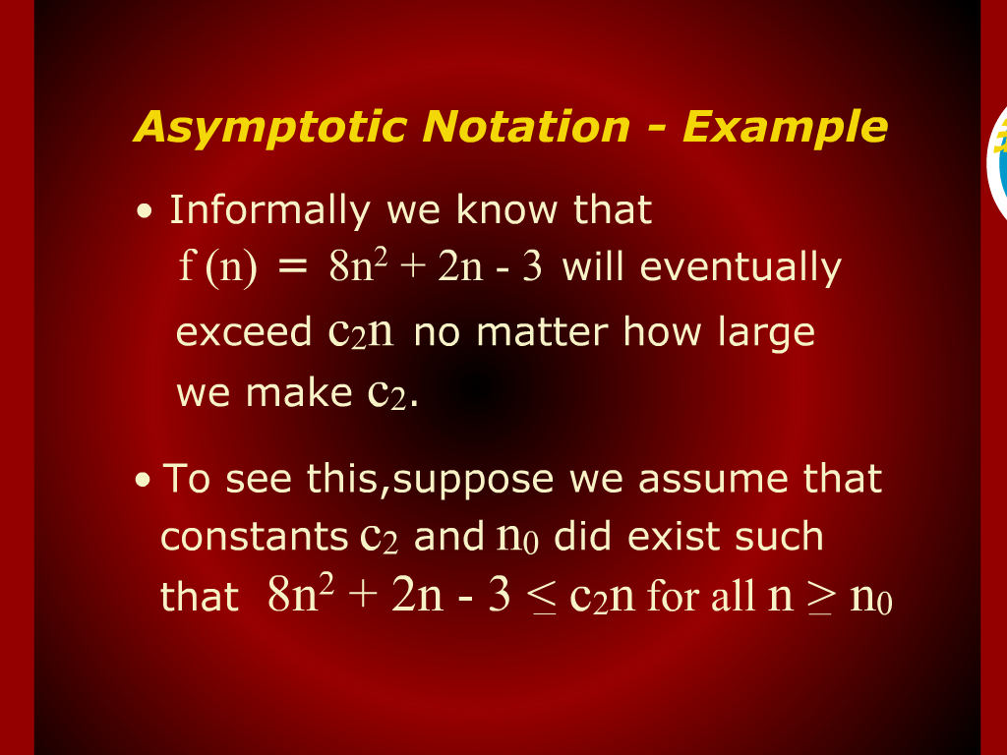
Asymptotic Notation - Example

Slide 18
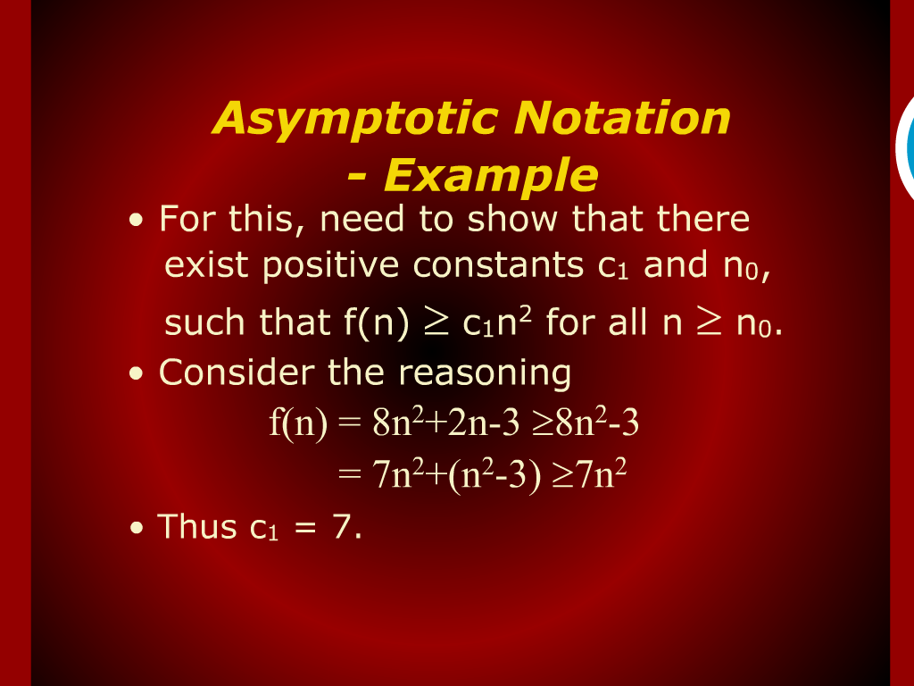
Asymptotic Notation- Example

Slide 19
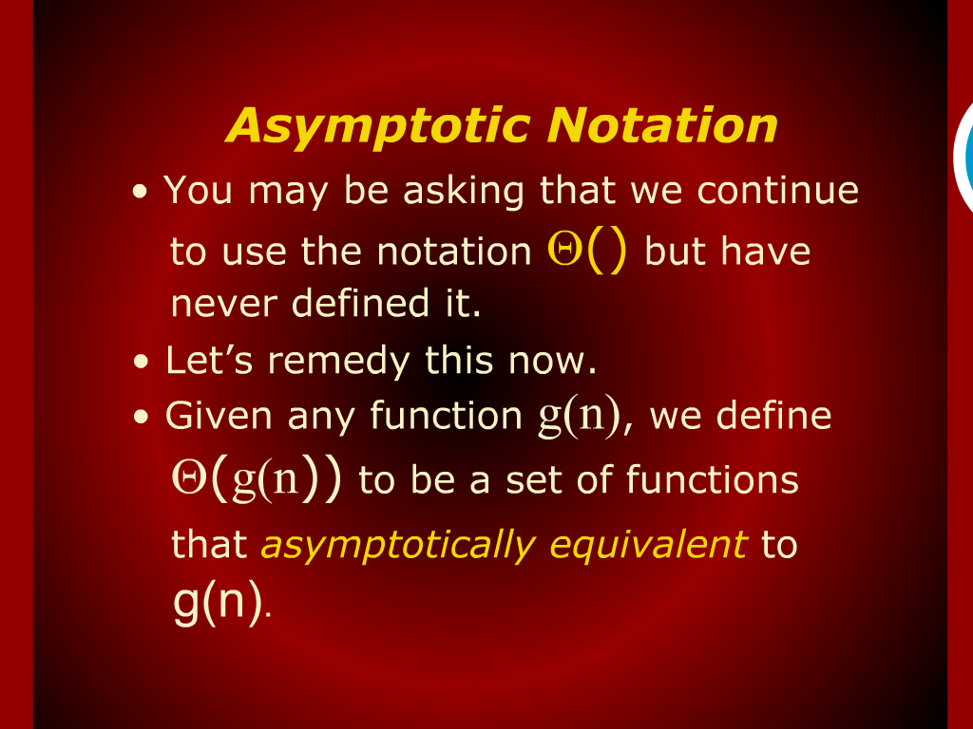
Asymptotic Notation

Slide 20
2-Dimension Maxima Revisited

Slide 21
Design & Analysis of Algorithms

Slide 22
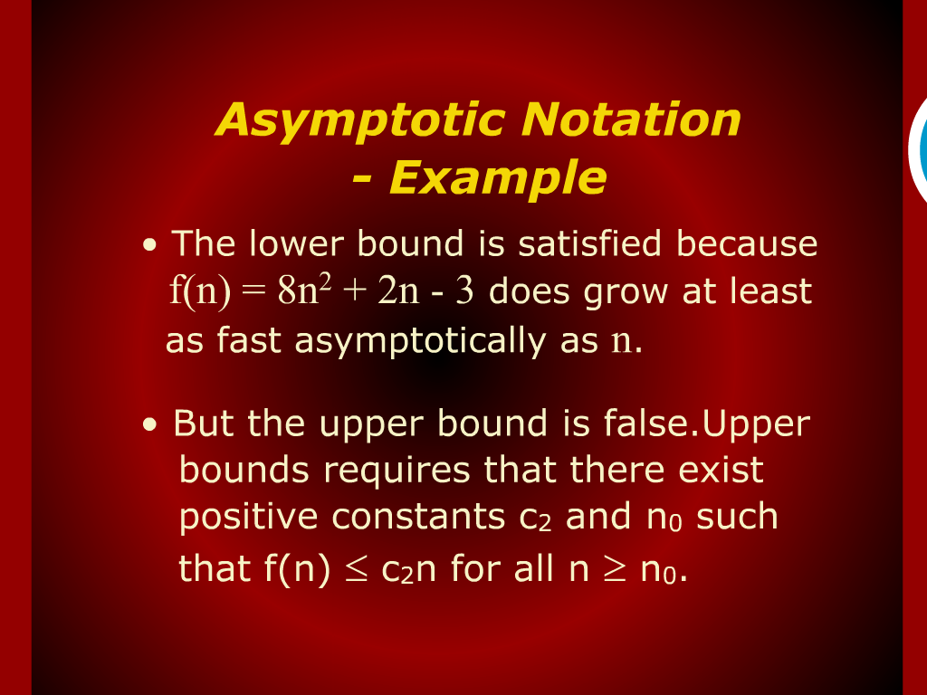
Asymptotic Notation Example

